Slide 1
The Supervised Learning Workshop Chapters 3 and 4
LY Catherine u21806799
QIU Lucie
QIU Loic u32109662
HOU Jiayan u32100601
WENG Christelle u32111006
WANG Louise

Slide 2
Introduction
Definitions :
Linear regression is a method used to find the straight line that best fits a set of
data points representing the relationship between two continuous variables. It is used to make predictions or understand how one variable affects another.
Autoregression is a method used to predict future values of a variable based on
its past values. It involves using a linear regression model to identify trends in
time series data and predict future values of the variable.
What is the use of linear regression & autoregression :
Linear regression is used in various fields while autoregression is commonly used in finance, economics, and weather forecasting.

Slide 3
Use case presentation and problem definiton
Does a simple linear regression allow us to approximate the evolution of temperatures over a period?
For the linear regression, we aim to predict or model continuous values, from recorded air temperatures from the years 1841 to 2010 ?

Slide 4
Data Analytics approach definition and explanation
Chapter 3 Linear regression
3.01 : Plotting data with a moving average
3.02 : Linear model using the least square methods
3.03 : Dummy variables
3.04 : Polynomial models with linear regression
3.05 : Linear regression with gradient descent
Chapter 4 Auto- regression
4.01 Auto-regression models

Slide 5
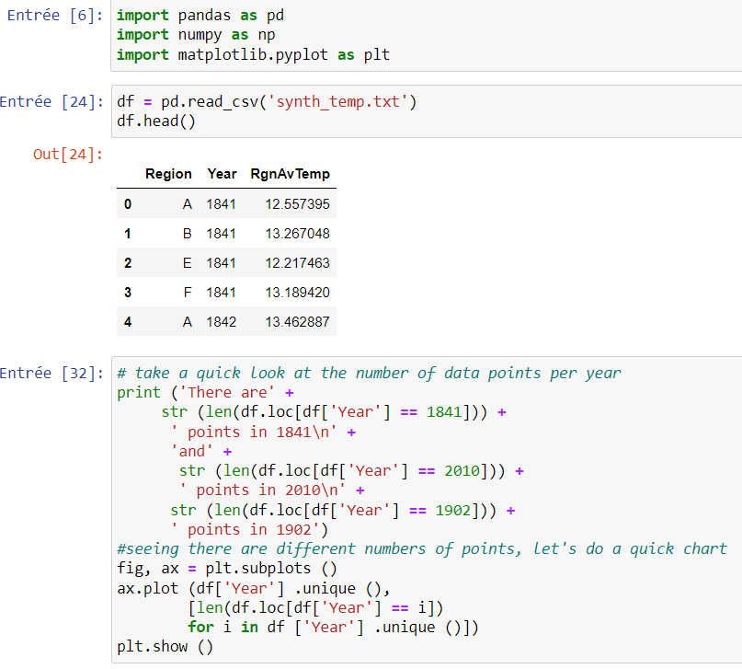
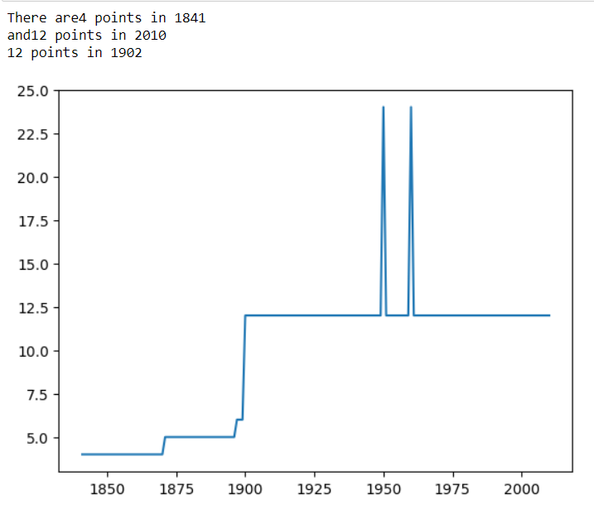
Chapter 3 – exercise 3.01 Catherine

Slide 6
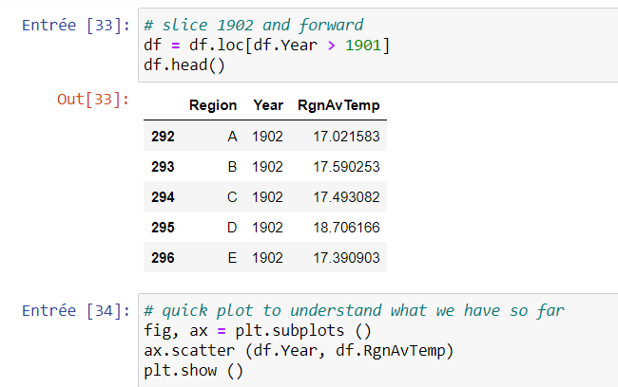
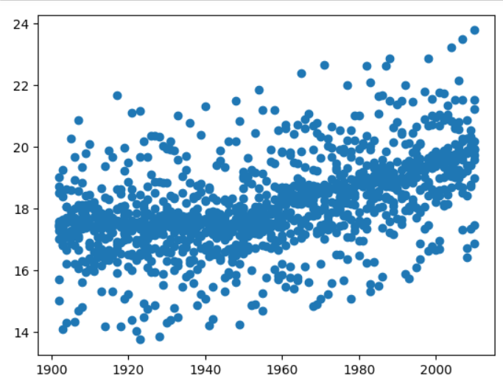
Chapter 3 – exercise 3.01 Catherine

Slide 7
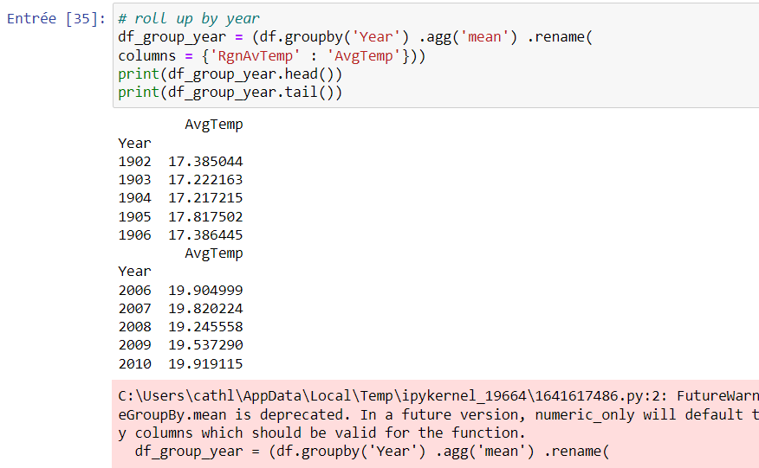
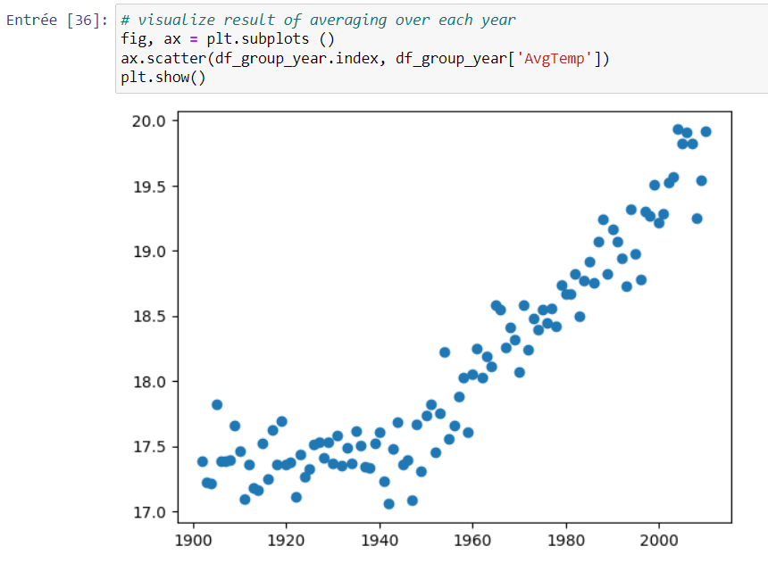
Chapter 3 – exercise 3.01 Catherine

Slide 8
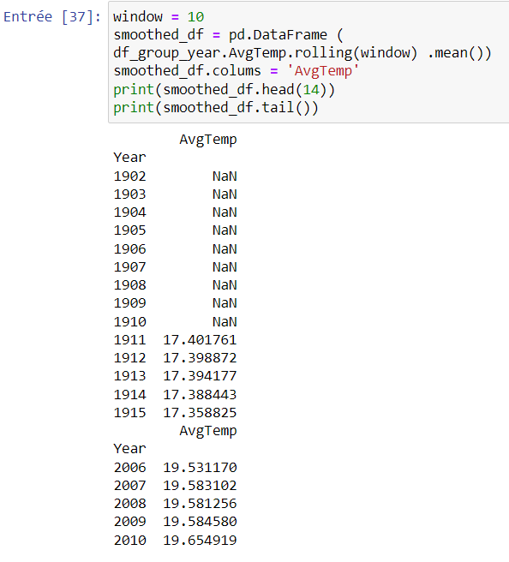
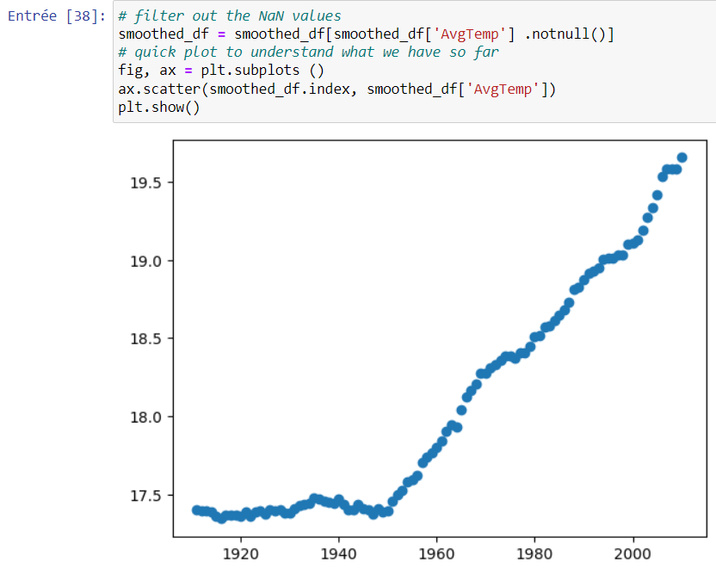
Chapter 3 – exercise 3.01 Catherine

Slide 9
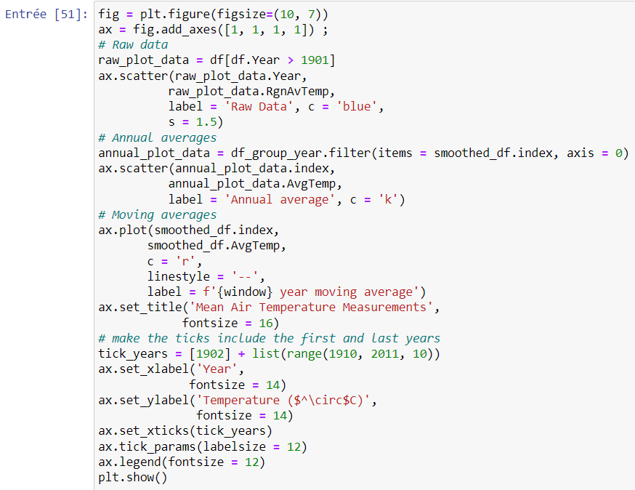
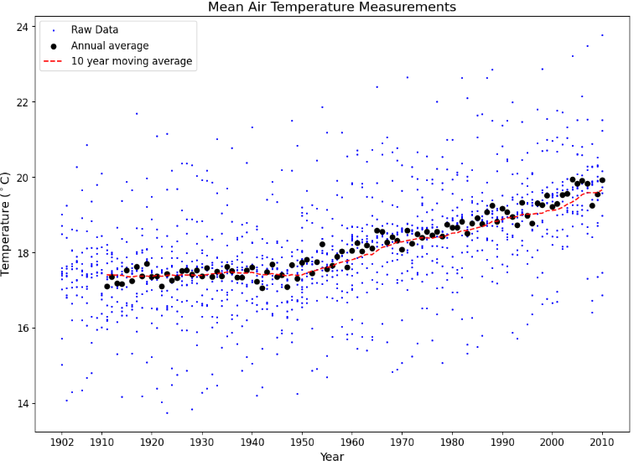
Chapter 3 – exercise 3.01 Catherine

Slide 10
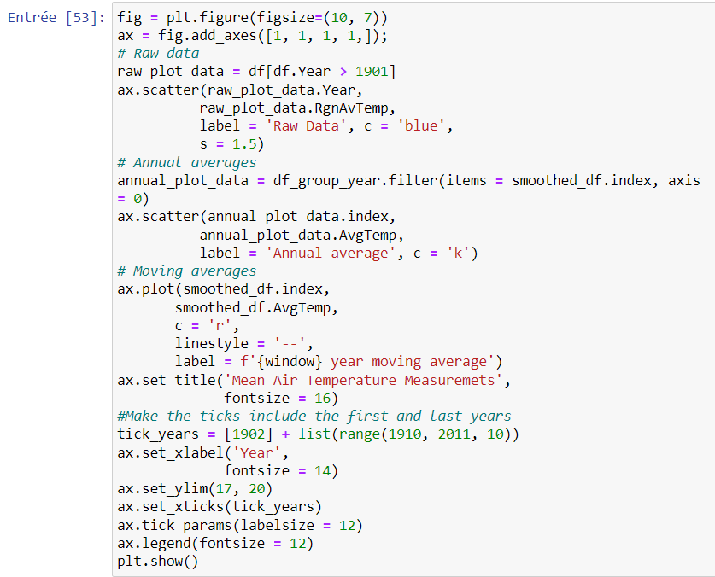
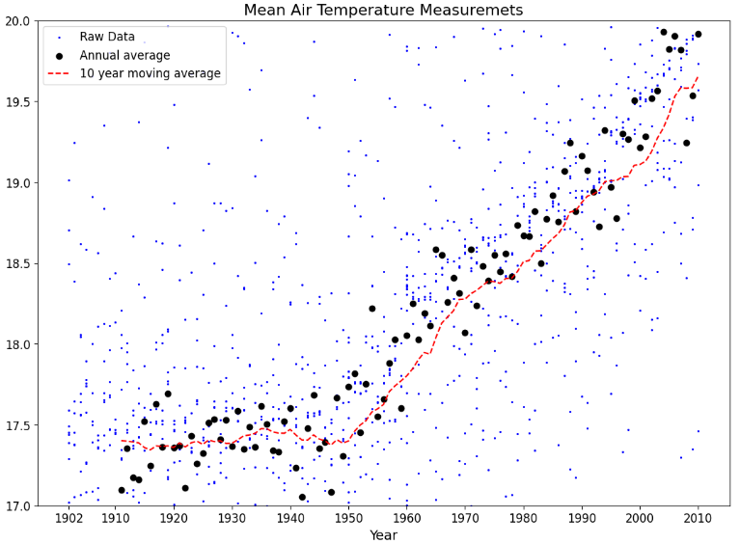
Chapter 3 – exercise 3.01 Catherine

Slide 11
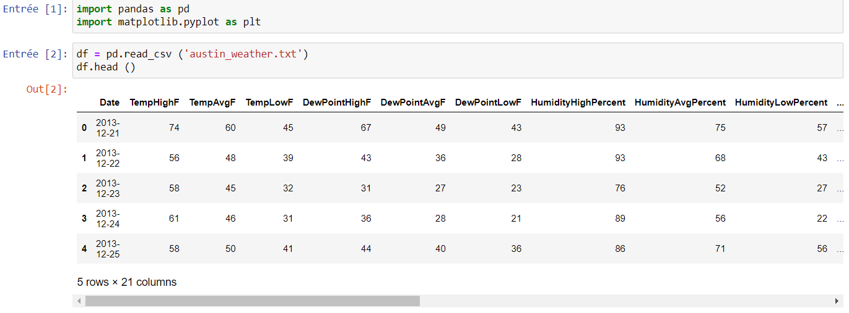
Chapter 3 – activity3.01 Catherine

Slide 12
Conclusion of exercise 3.01
Thanks to the first exercise of the chapter 3, we learnt how to upload dataset, how to use different functions such as plt.show(); print (); how to read a dataset.

Slide 13
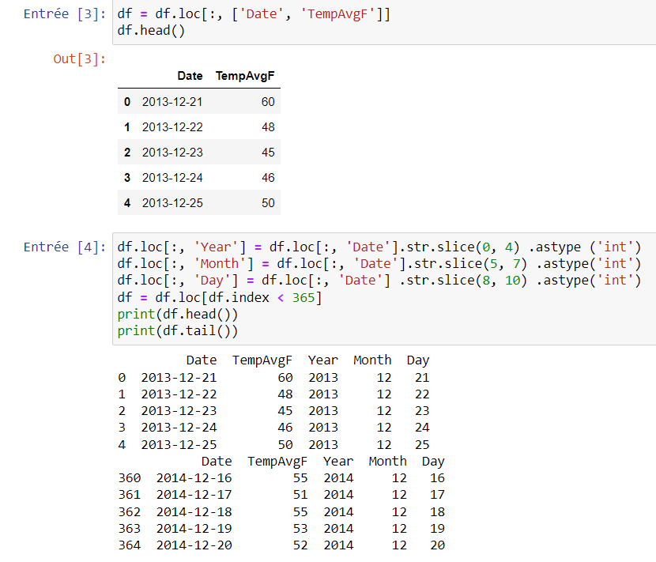
Chapter 3 – activity3.01 Catherine

Slide 14
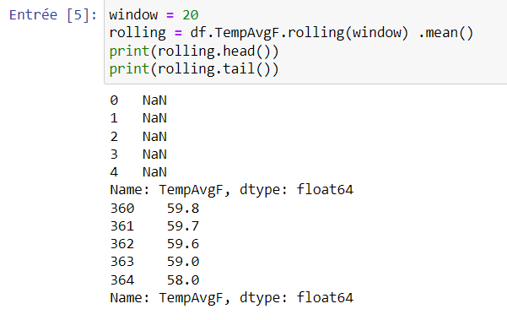
Chapter 3 – activity3.01 Catherine

Slide 15
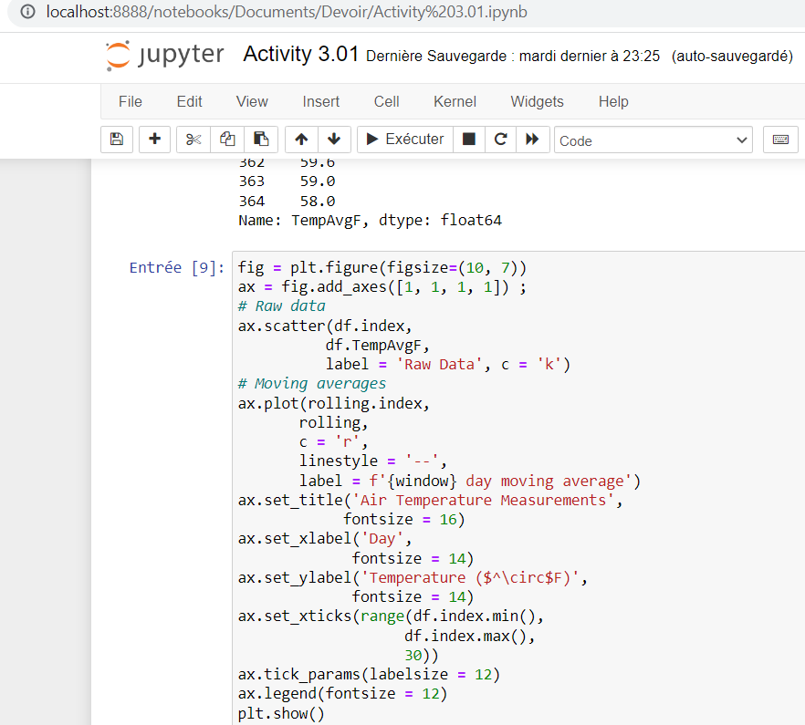
Chapter 3 – activity3.01 Catherine

Slide 16
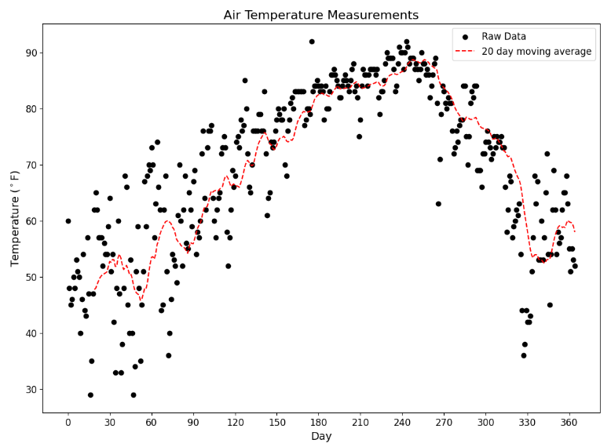
Chapter 3 – activity3.01 Catherine

Slide 17
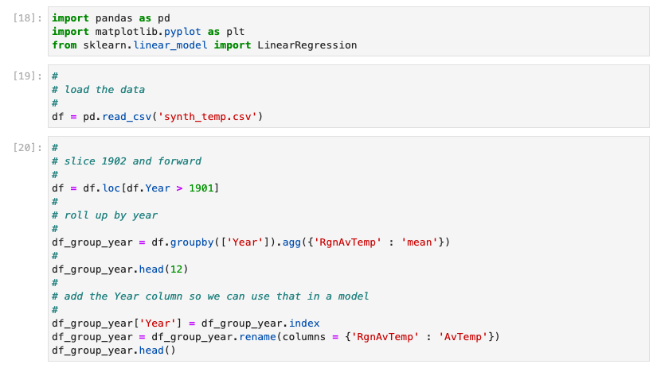
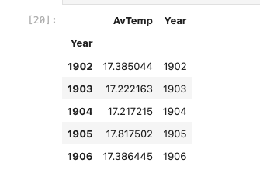
Chapter 3 – exercise 3.02 Christelle
Notes:
In this exercise, I will construct a linear regression model using the least squares method to visualize the air temperatures over a yearly timeframe
18. This code is like opening a toolbox that has different tools in it that you can use to work with data, create pictures, and build a special type of math model called a linear regression model. It's like getting ready to do a project and making sure you have all the tools you need to do it.
Pandas (as "pd"), a library for data manipulation and analysis
Matplotlib.pyplot (as "plt"), a library for data visualization
LinearRegression from scikit-learn's linear_model module, a library for building linear regression models
19. This code reads will read our files 'synth_temp.csv', which has some data in it. It then puts that data into a special type of table called a DataFrame that makes it easy to work with the data in Python.
20.code selects and manipulates a table of data to calculate average temperatures for each year starting from 1902. It adds a "Year" column and renames the temperature column before displaying the resulting table.

Slide 18
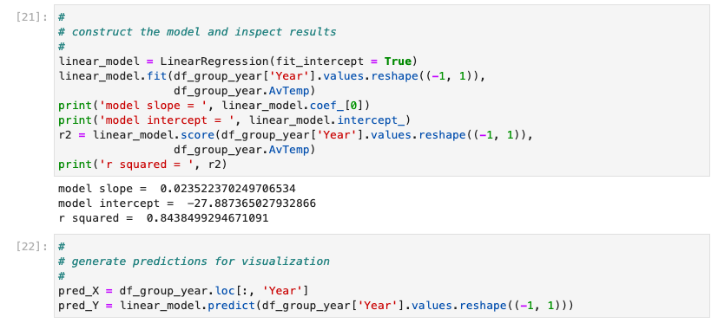
Chapter 3 – exercise 3.02 Christelle
Notes:
21. This code creates a line that best represents the relationship between the "Year" and "AvTemp" columns in a DataFrame using linear regression. It then calculates how well the line fits the data.
this code constructs and fits a linear regression model to the data, and prints out some basic information about the model, including its slope, intercept, and R-squared value. The R-squared value gives an indication of how well the linear model fits the data, with a value of 1 indicating a perfect fit and a value of 0 indicating no relationship between the variables. In our case, r-squared value is 0.84 which is / This code constructs a linear model that predicts temperature based on the year. It calculates the slope and intercept of the line, as well as the coefficient of determination (r-squared) which tells us how well the model fits the data.
22. This code uses the linear regression model created earlier to predict what the average temperature would be for each year in the DataFrame. The predicted values will be used to create a visualization of the linear regression line.

Slide 19
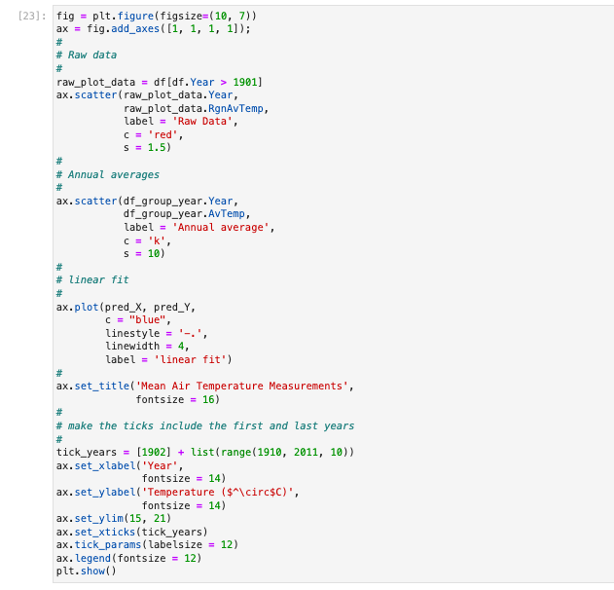
Chapter 3 – exercise 3.02 Christelle
This code is to create a scatter plot with a linear regression line and set various properties of the graph such as :
the title, ax.set
the axis labels, ax.set_xlabel
the tick marks : ax.tick.param
the legend : ax.legend
Notes:
This code is to create a scatter plot with a linear regression line and the plot displays the average air temperature measurements for each year between 1902 and 2010.
and set various properties of the graph such as :
the title, ax.set
the axis labels, ax.set_xlabel
the tick marks : ax.tick.param
the legend : ax.legend(

Slide 20
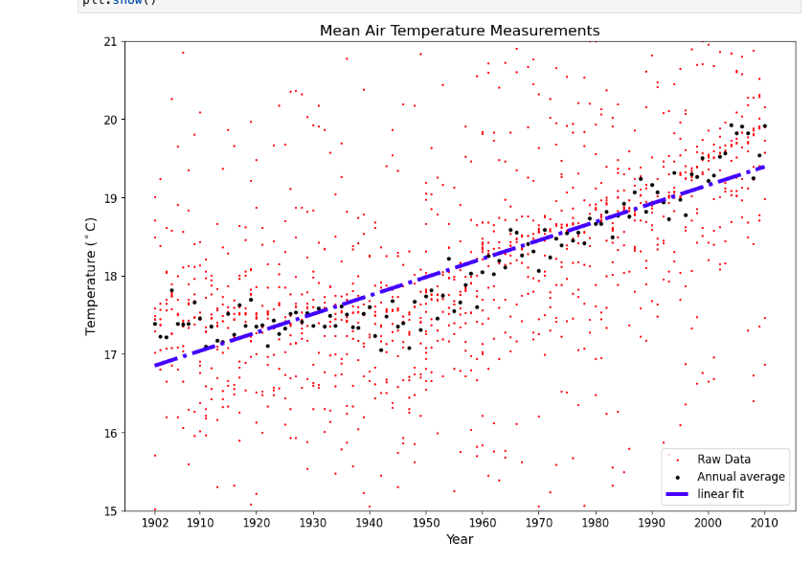
Chapter 3 – exercise 3.02 Christelle
In this graph :
raw data points are too scattered
the annual averages are fairly spread
don't seem to follow a perfectly straight line
So this method/ model is not suitable for our data.
Notes:
This is our final result and we can see that in this graph :
raw data points are too scattered
the annual averages are fairly spread
don't seem to follow a perfectly straight line
So this method/ model is not suitable for our data.

Slide 21
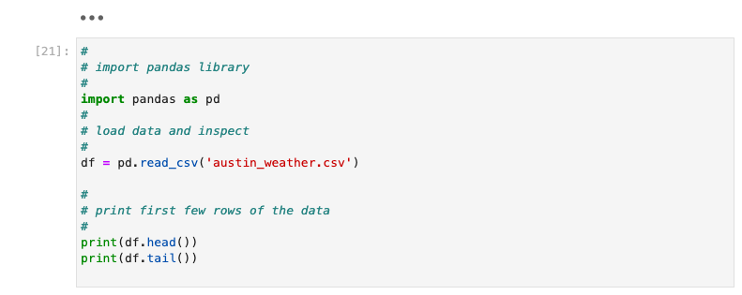
Chapter 3 – Activity 3.02 Christelle
Notes:
And for the activity 3.02, I ran the code and you will find all the screenshots of the code in the next slides

Slide 22
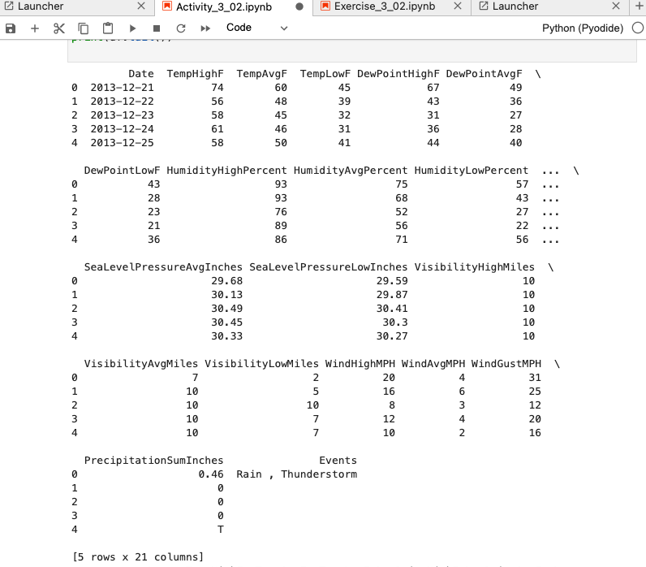
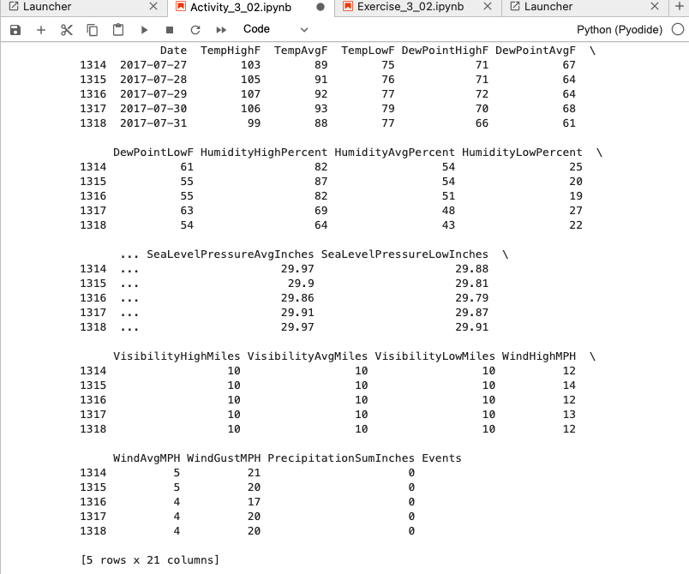
Chapter 3 – Activity 3.02 Christelle
The head() method
the tail() method
Notes:
The head() method will show you the first 5 rows of the data, while the tail() method will show you the last 5 rows of the data

Slide 23
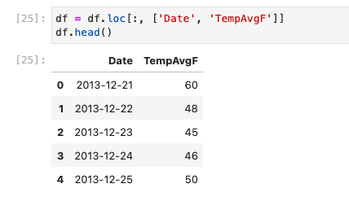
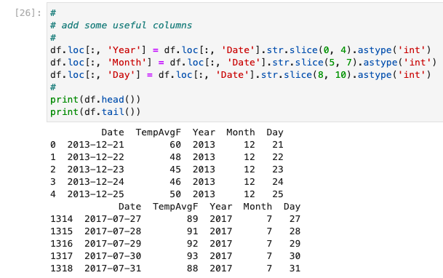
Chapter 3 – Activity 3.02 Christelle
Notes:
1.Drop everything except the Date and TempAvgF columns.
2. Create new Year, Month, and Day columns and populate them by parsing the
Date column:

Slide 24
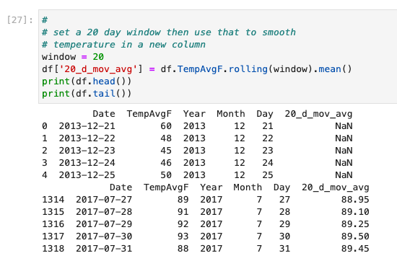
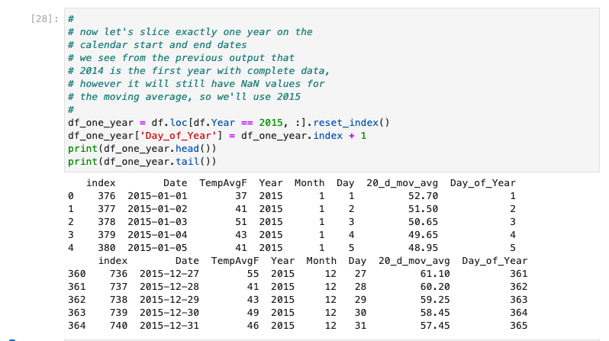
Chapter 3 – Activity 3.02 Christelle
Notes:
Create a new column for a moving average and populate it with a 20-day moving
average of the TempAvgF column:
Slice one complete year of data to use in a model. Ensure the year doesn't have
missing data due to the moving average. Also create a column for Day_of_Year
(it should start at 1):

Slide 25
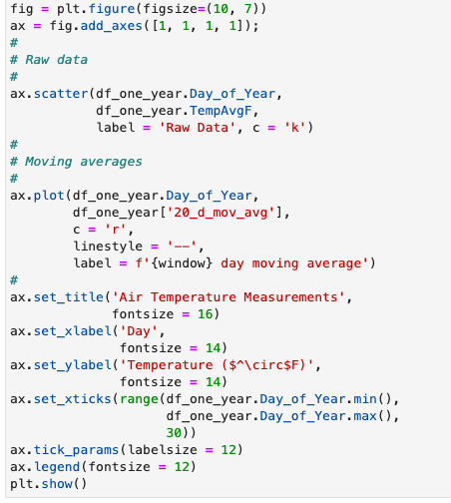
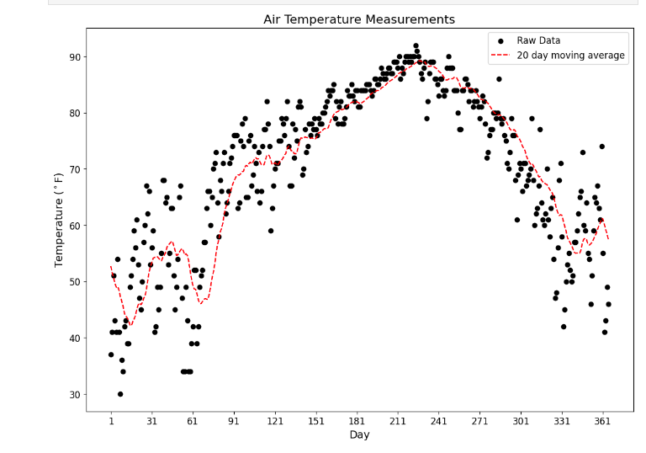
Chapter 3 – Activity 3.02 Christelle
Notes:
7. Create a scatterplot of the raw data (the original TempAvgF column) and overlay it
with a line for the 20-day moving average:

Slide 26
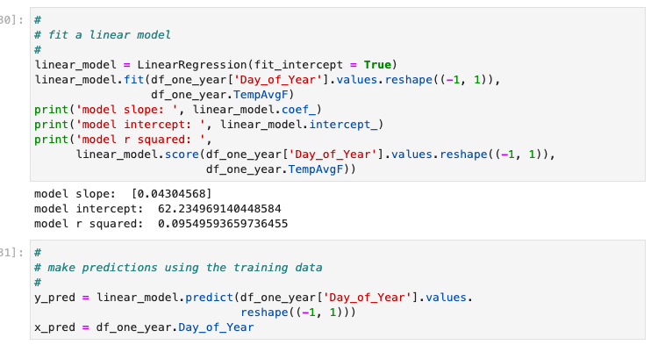
Chapter 3 – Activity 3.02 Christelle
Notes:
Create a linear regression model using the default parameters, that is, calculate
a y intercept for the model and do not normalize the data. The day numbers for the
year (1 to 365) constitute the input data and the average temperatures constitute
the output data. Print the parameters of the model and the r2
value:
9. Generate predictions from the model using the same x data:

Slide 27
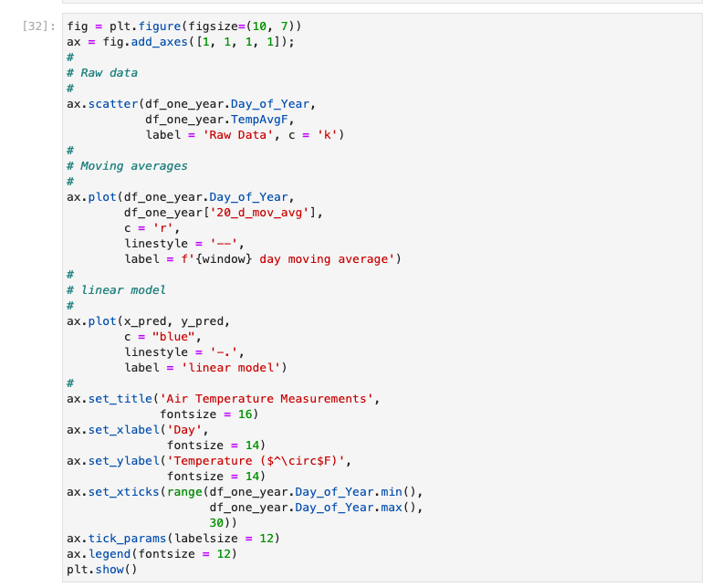
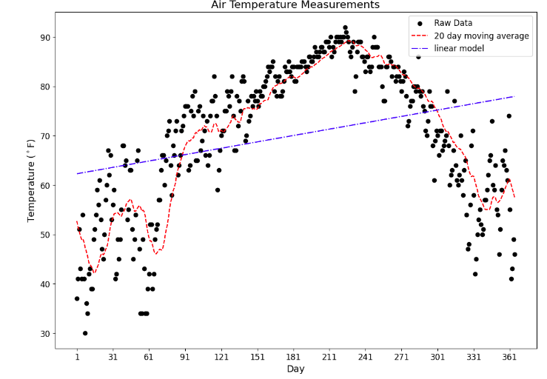
Chapter 3 – Activity 3.02 Christelle

Slide 28
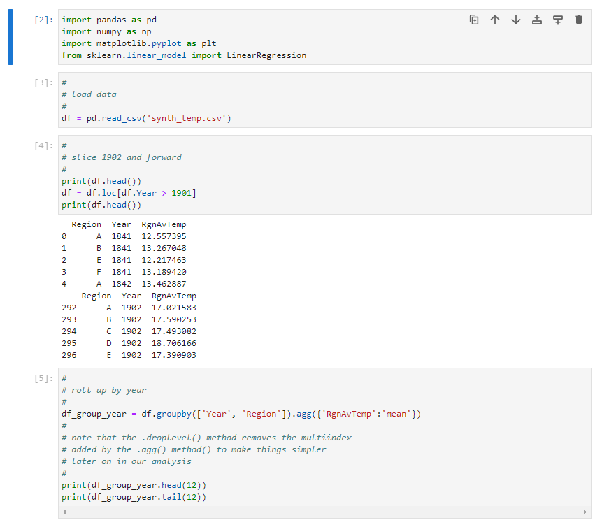
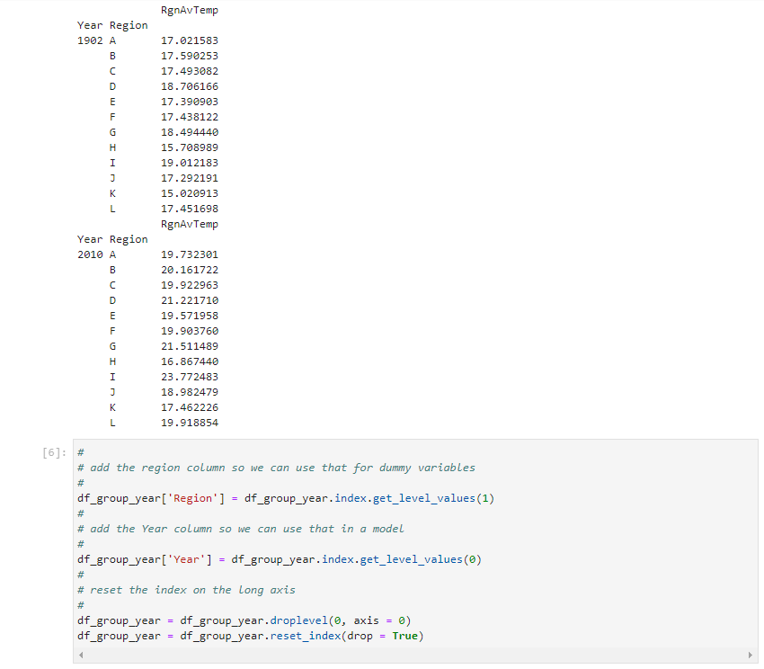
Chapter 3 – exercise 3.03 Loic

Slide 29
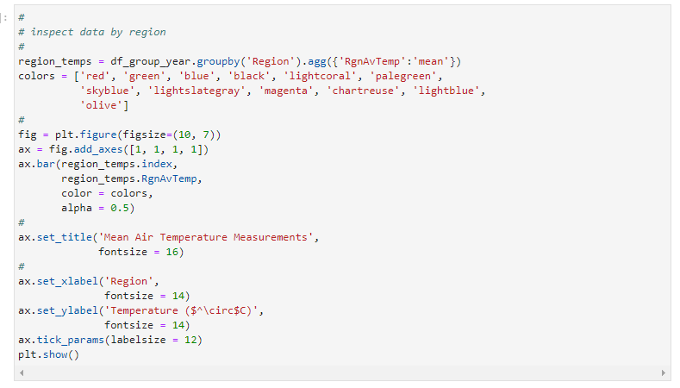
Chapter 3 – exercise 3.03 Loic

Slide 30
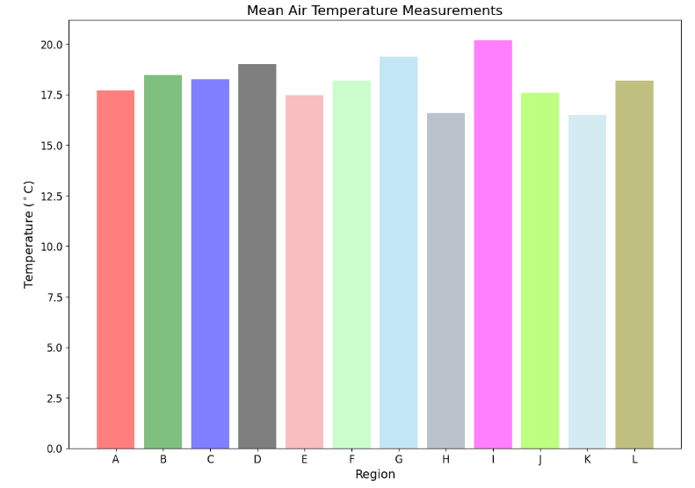
Chapter 3 – exercise 3.03 Loic

Slide 31
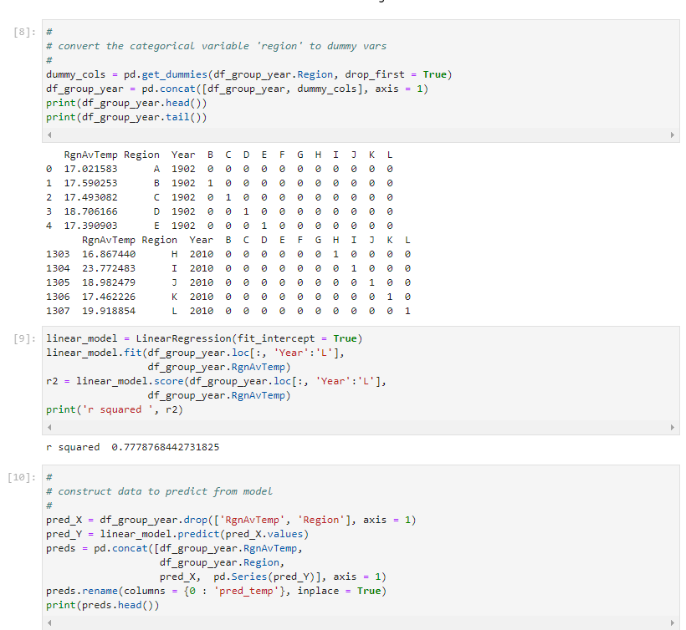
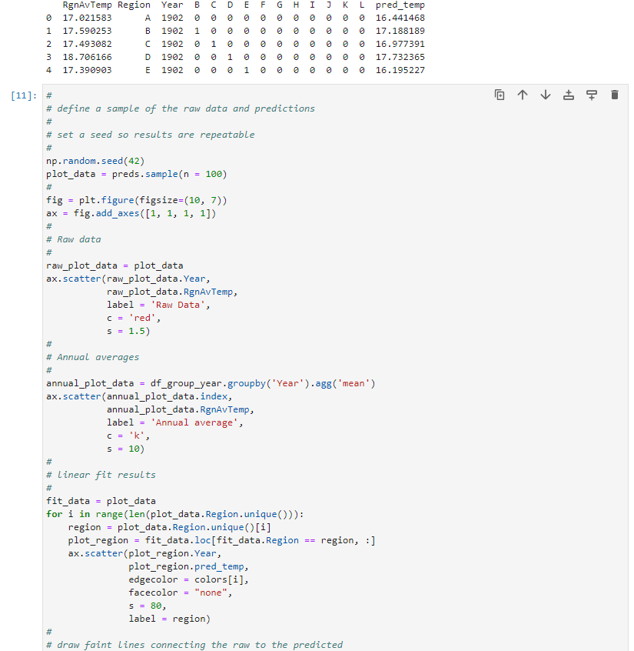
Chapter 3 – exercise 3.03 Loic

Slide 32
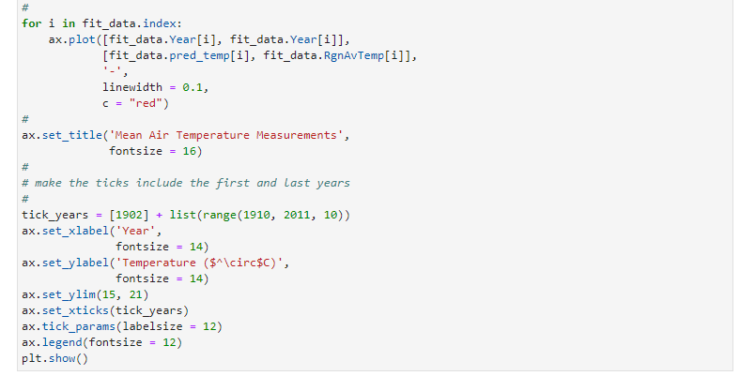
Chapter 3 – exercise 3.03 Loic

Slide 33
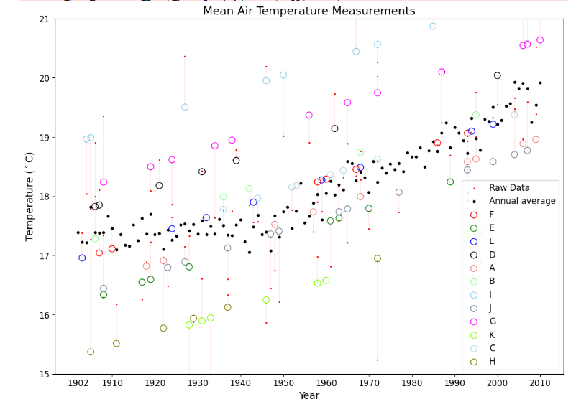
Chapter 3 – exercise 3.03 Loic

Slide 34
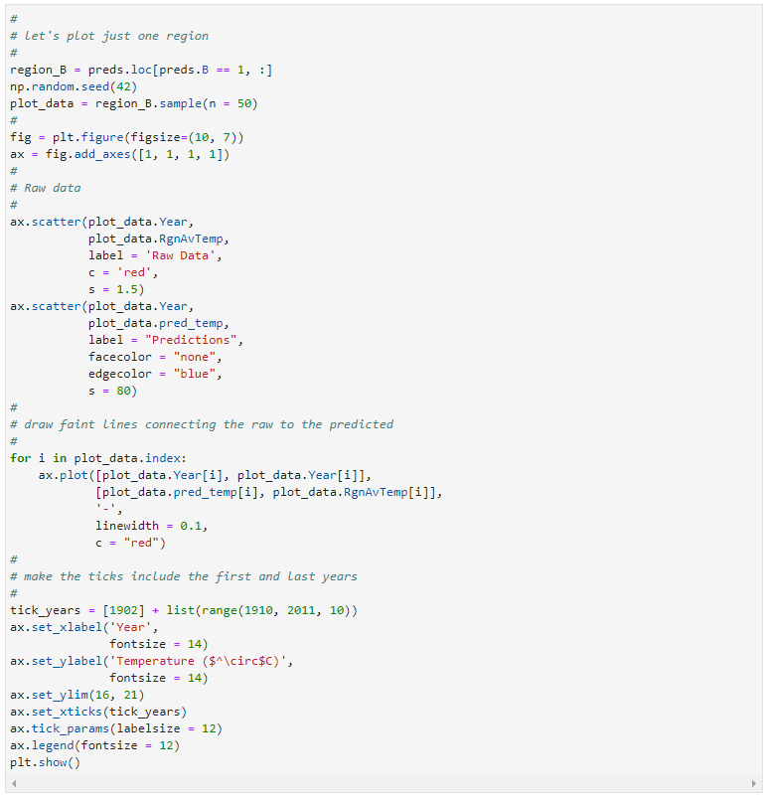
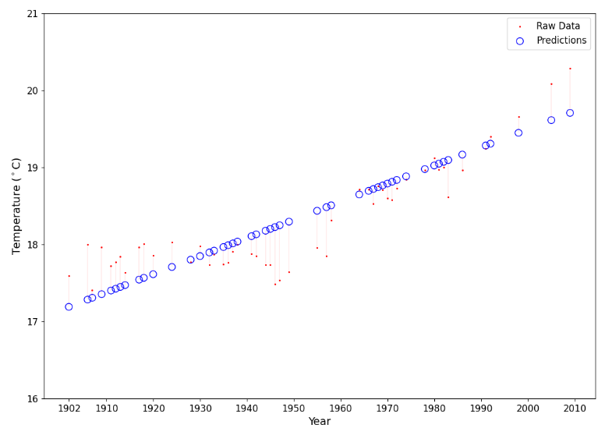
Chapter 3 – exercise 3.03 Loic

Slide 35
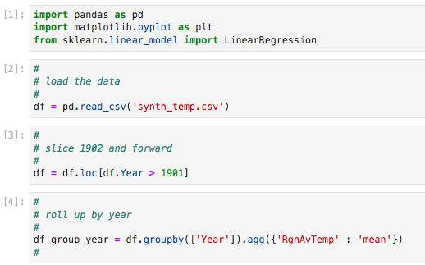
Chapter 3 – exercise 3.04 Jiayan

Slide 36
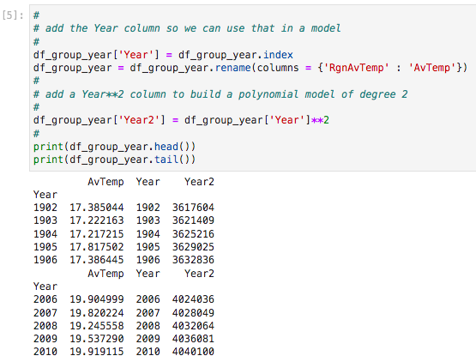
Chapter 3 – exercise 3.04 Jiayan

Slide 37
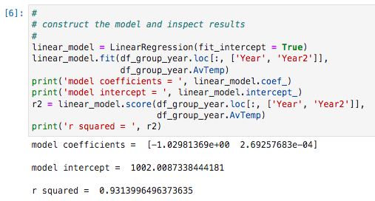
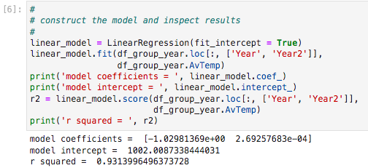
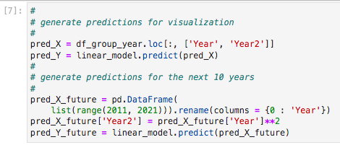
Chapter 3 – exercise 3.04 Jiayan
After PLAY
Before PLAY

Slide 38
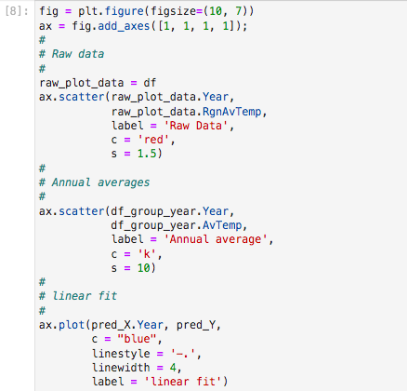

Chapter 3 – exercise 3.04 Jiayan

Slide 39

Chapter 3 – exercise 3.04 Jiayan

Slide 40

Chapter 3 – exercise 3.05 Lucie

Slide 41


Chapter 3 – exercise 3.05 Lucie

Slide 42


Chapter 3 – exercise 3.05 Lucie

Slide 43


Chapter 3 – exercise 3.05 Lucie

Slide 44


Chapter 3 – exercise 3.05 Lucie

Slide 45

Chapter 3 – exercise 3.05 Lucie

Slide 46


Chapter 4 – exercise 4.01 Louise

Slide 47


Chapter 4 – exercise 4.01 Louise

Slide 48


Chapter 4 – exercise 4.01 Louise

Slide 49


Chapter 4 – exercise 4.01 Louise

Slide 50



Chapter 4 – exercise 4.01 Louise

Slide 51



Chapter 4 – exercise 4.01 Louise

Slide 52


Chapter 4 – exercise 4.01 Louise

Slide 53


Chapter 4 – exercise 4.01 Louise

Slide 54




Chapter 4 – exercise 4.01 Louise

Slide 55
Conclusion
To conclude, both linear regression and autoregression are valuable tools for analyzing data and making predictions. However, they are suited for different types of data and applications.
Linear regression is useful when examining the relationship between two variables, while autoregression is ideal for analyzing time-series data.

